Slide 1
Starbucks web application
The Ninjans: Junteng Tan, Jia Ma, Ying Liu

Slide 2
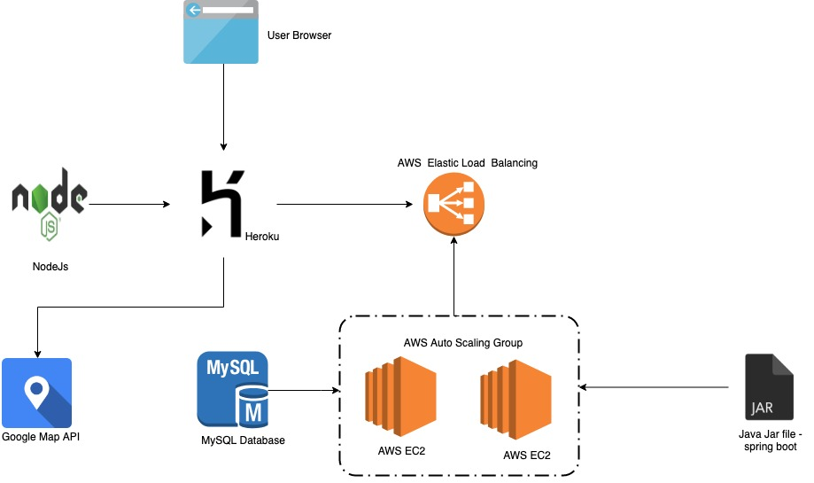
Deployment Diagram

Slide 3
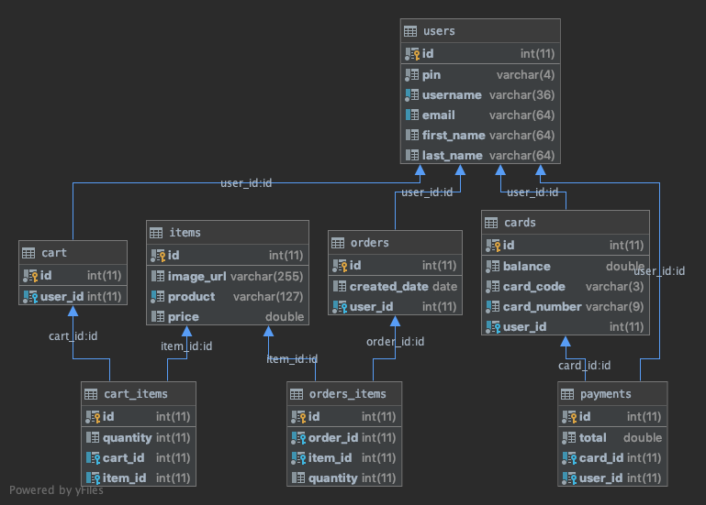
Component Diagram

Slide 4
Implemented Features with Team Member Contribution
Add Cards API (Jia Ma)
Managed Order API (JunTeng Tan)
Payment API (JunTeng Tan)
User API (Ying Liu)
Map API (Jia Ma)
Extra: Deploy API to AWS in an Auto Scaled EC2 Cluster with Load Balancer (JunTeng Tan)
Extra: Web "Front-End" Deployed to Heroku for Starbucks Payment Card management: https://starbucks-web.herokuapp.com (Jia Ma)
Agile project management and documentation: Ying Liu

Slide 5
Agile & scrum
Ying Liu

Slide 6
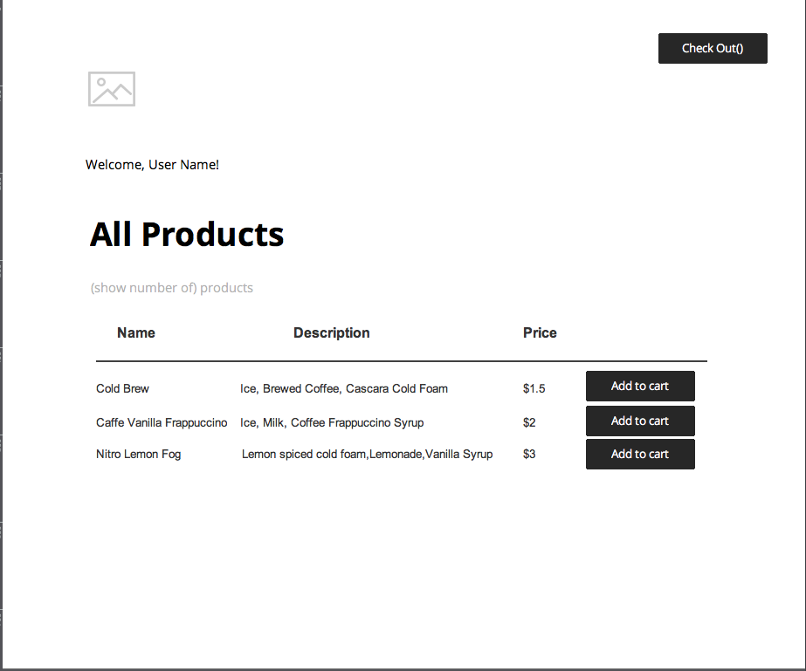
UI Wireframe (Used a drawing tool: JustinMind)

Slide 7
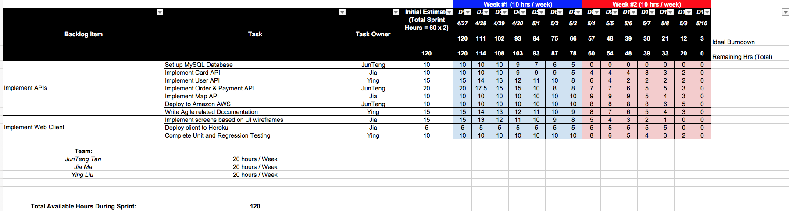
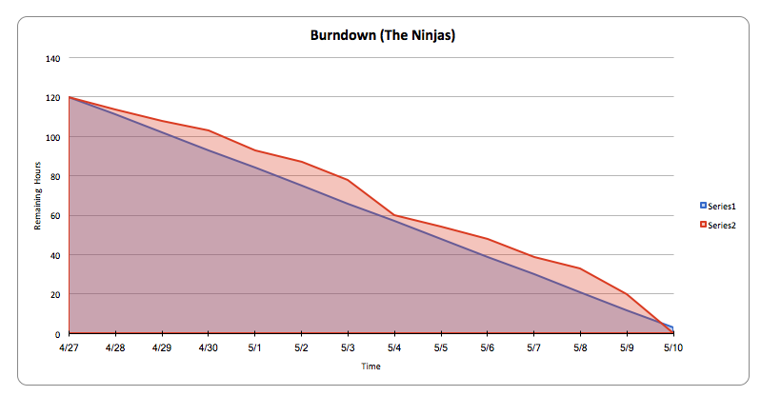
Burndown Chart

Slide 8
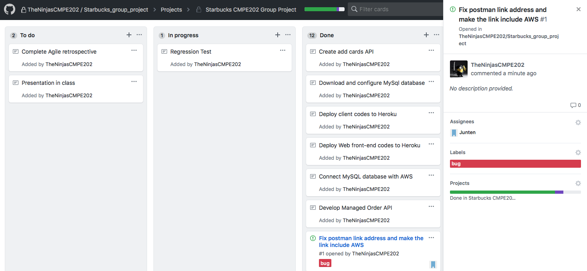
Github Project Board

Slide 9
Api deMO
Junteng Tan

Slide 10
Delete Card Demo
Let’s view what cards exist currently: Get card/get_all_cards
Delete one of the card: Del card/delete_card_by_card_id
Input "card_id":1 in the body, Send Delete request
Card with id 1 does not exist after the deletion request: Get card/get_all_cards

Slide 11
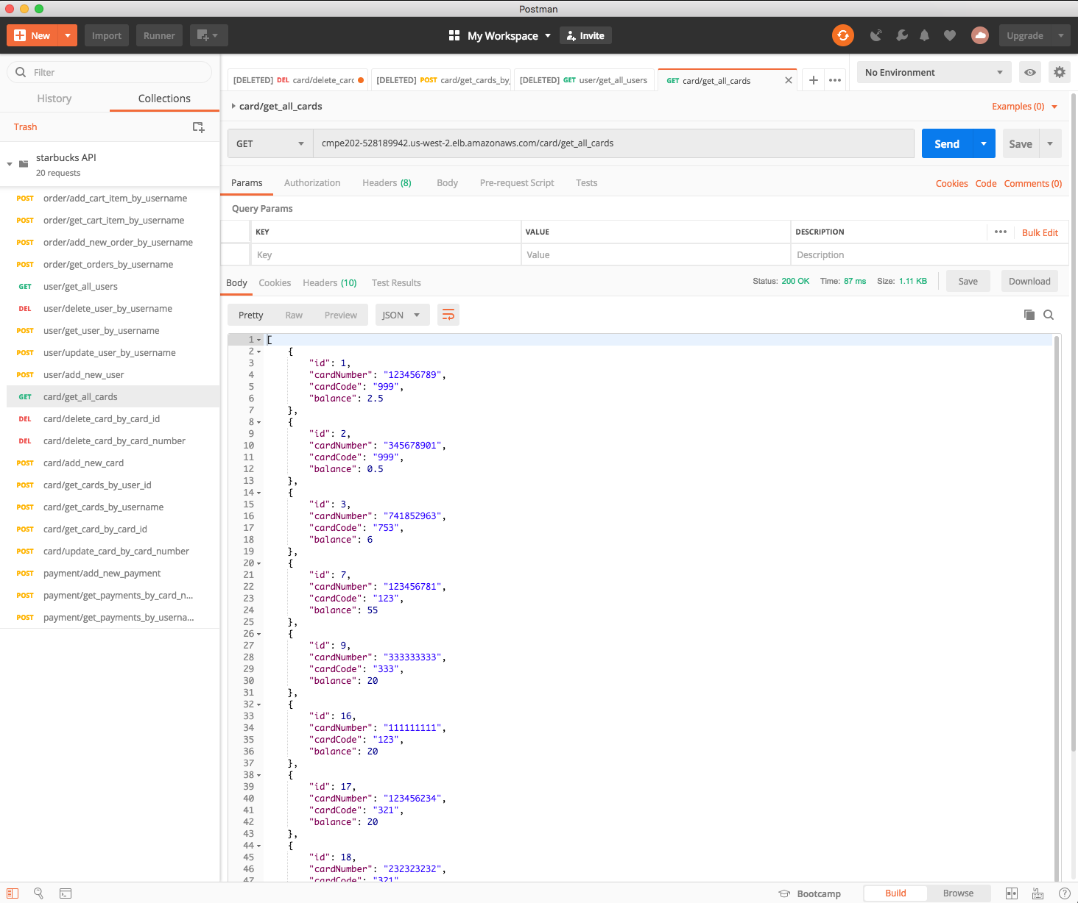

Slide 12
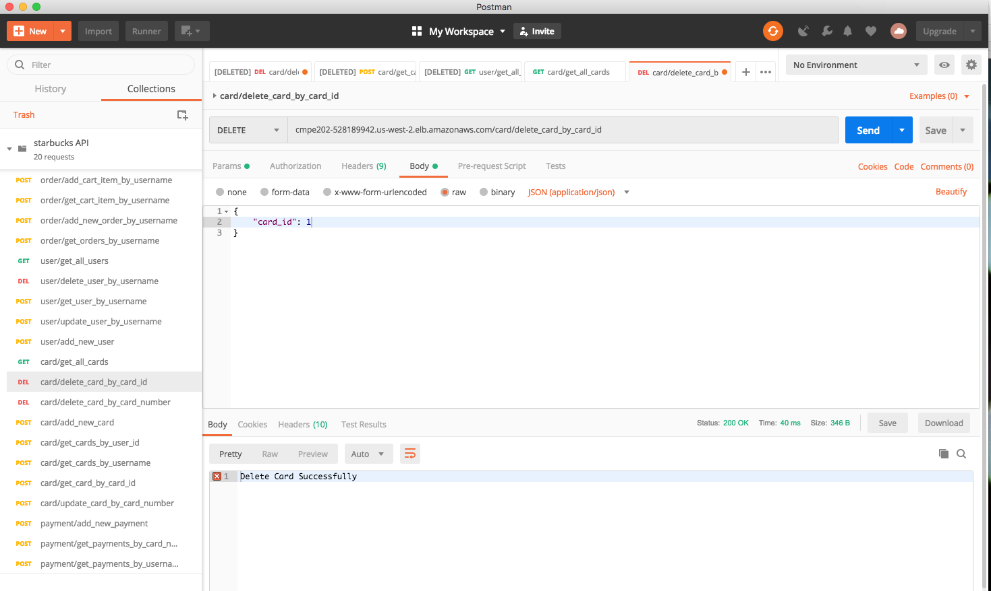

Slide 13
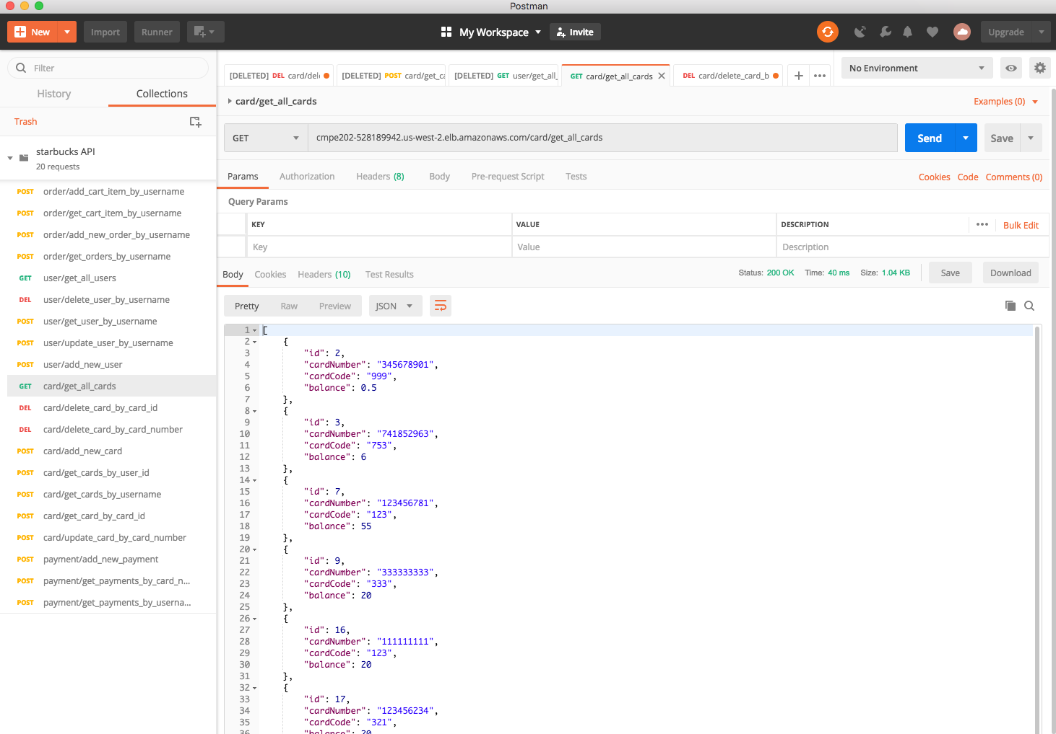

Slide 14
Add New User Demo
Get user/get_all_users
Del user/delete_user_by_username
Input "card_id":1 in the body, Send Delete request
Get card/get_all_cards again: the card with “id = 1” disappreas

Slide 15
Web deMO
Jia Ma

Slide 16
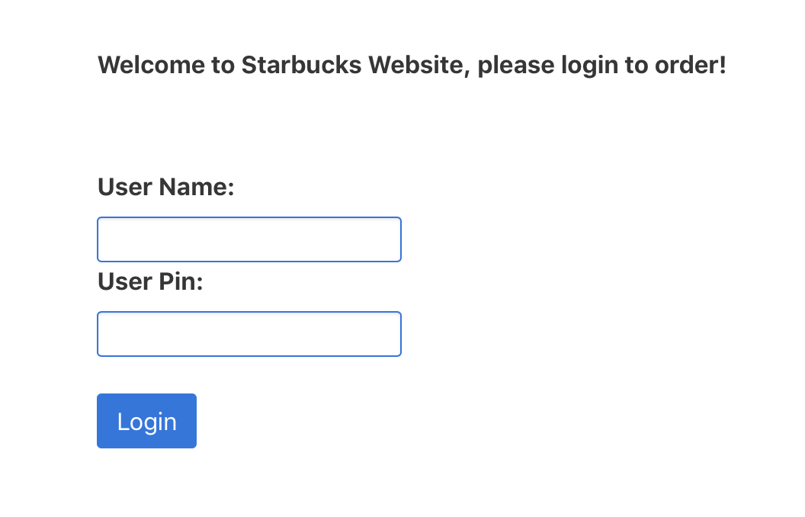
Log in: https://starbucks-web.herokuapp.com User: Jenny Password: 1234

Slide 17
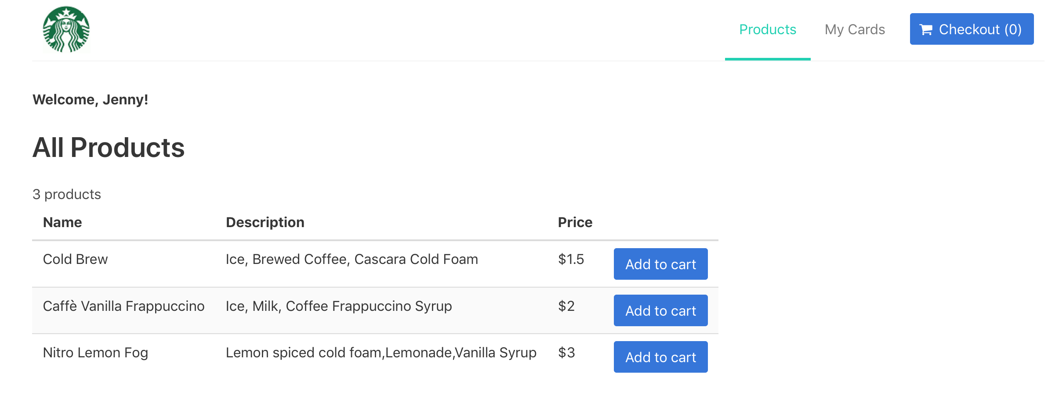

Slide 18
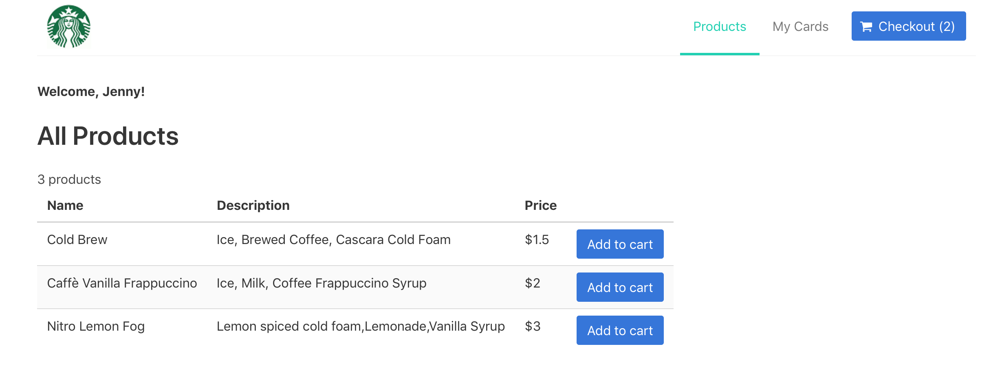

Slide 19
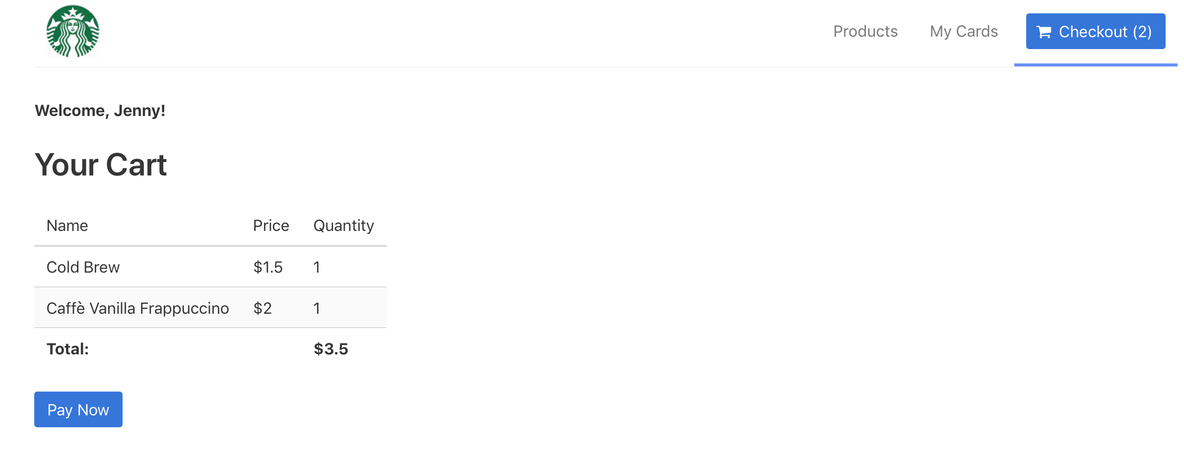

Slide 20
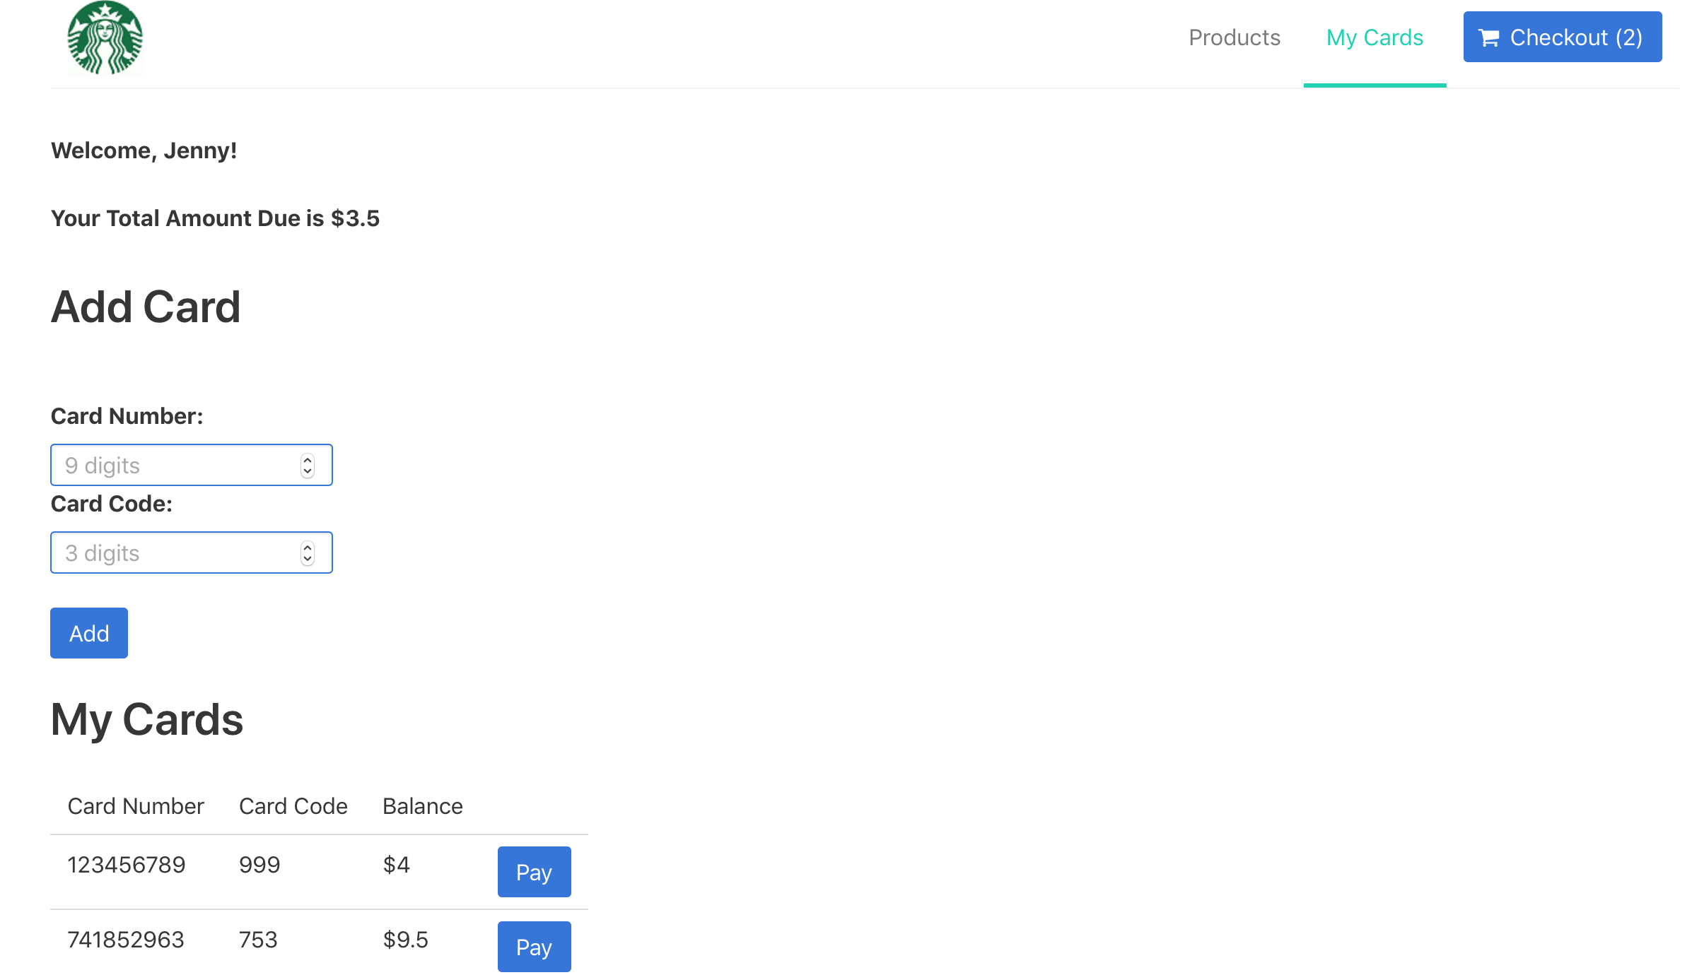

Slide 21
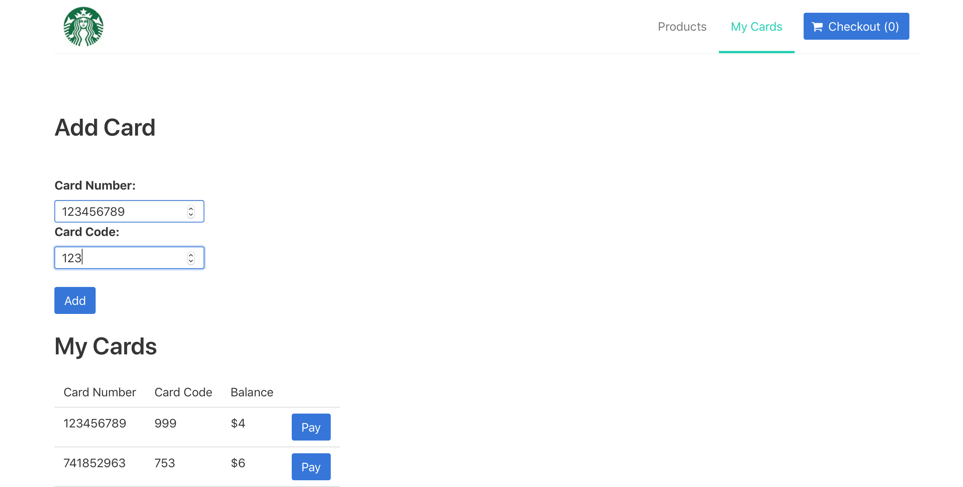

Slide 22
